Slide 1
Brain Invaders
Creating a P300-controlled game

Slide 2
Introduction
Gaming with BCI growing field
  Potential commercial adoption
Using P300-paradigm in game
  Based on classic Space Invaders
Brain Invaders - Creating a P300-controlled game

Slide 3
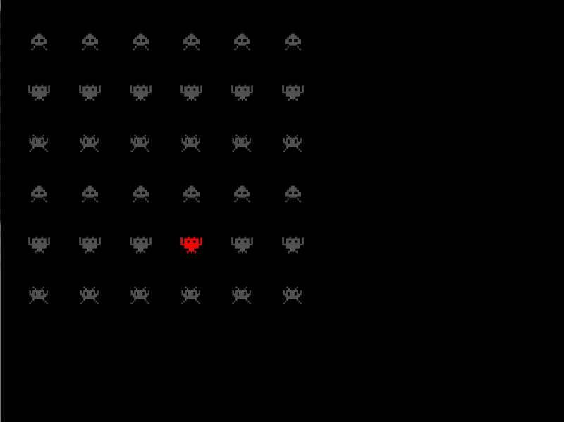
Previous Version¹
32 moving Aliens
Target to shoot within 14 moves
Repeat for multiple blocks
Target could be hit in
1-3 repetitions in ~50%
of the cases
Flashes randomized
[1] Congedo, M., Goyat, M., Tarrin, et al. "Brain Invaders": a prototype of an open-source P300-based video game working with the OpenVIBE platform. In Proceedings of the 5th International Brain-Computer Interface Conference 2011 (Graz, Austria, 2011)
Brain Invaders - Creating a P300-controlled game

Slide 4
Room for Improvement
Gameplay not taken into account
  Boring
  No Progression
  No challenge
Technically not made for extension
Brain Invaders - Creating a P300-controlled game

Slide 5
New Goals
Apply Game Design Theories to improve Challenge
Create multiple levels
Make visually more appealing
Brain Invaders - Creating a P300-controlled game

Slide 6
Concepts from Game Design Theories
Brain Invaders should consider theories from Game Design
  Flow Theory¹
  Paradox of Control²
[1] Csikszentmihalyi, M. Flow: The Psychology of Optimal Experience. Harper Perennial, London, 1990.
[2] Salen, K. and Zimmerman, E. Rules of Play: Game Design Fundamentals. MIT Press, Cambridge, Massachusetts, 2003.
Brain Invaders - Creating a P300-controlled game

Slide 7
Distractions
To Improve challenge we pose the concept of distractors.
  Different Colors and Movement
  Will cover the requirements of a paradox of control
Brain Invaders - Creating a P300-controlled game

Slide 8
New Version
Support for more levels
  Level Building Tool
Dynamic Movement
Distractors
Clearer Interface
Brain Invaders - Creating a P300-controlled game

Slide 9
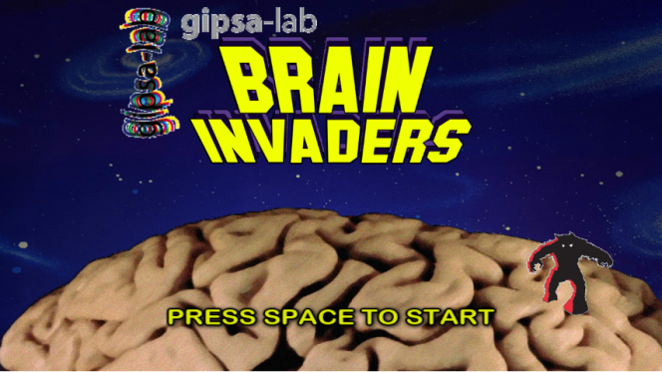
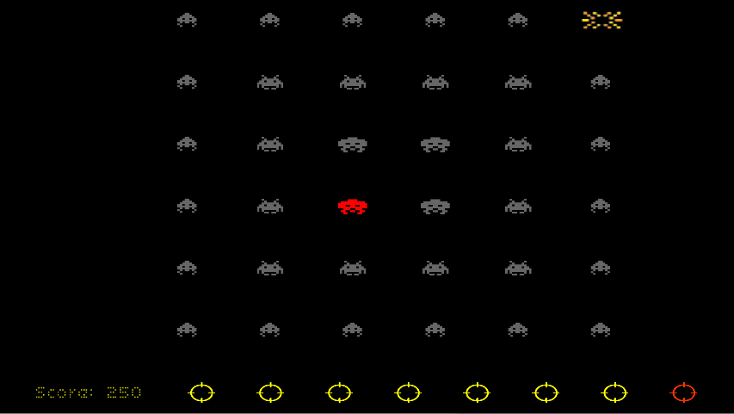
Screenshots
Brain Invaders - Creating a P300-controlled game

Slide 10
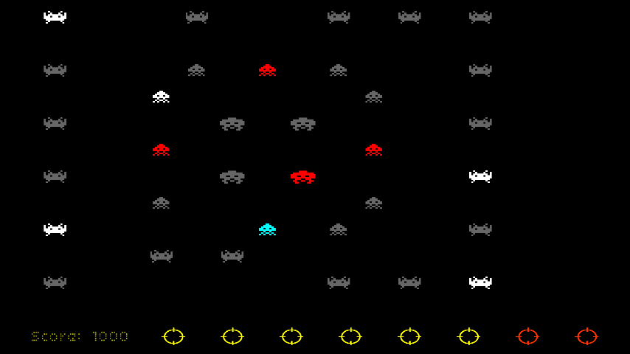
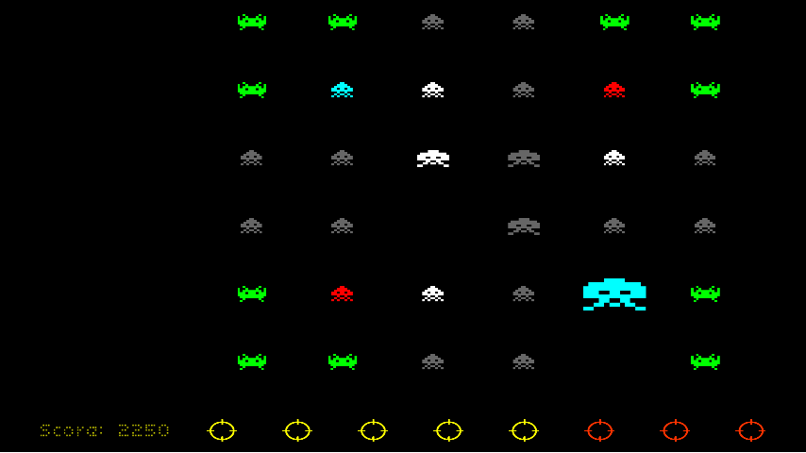
Screenshots
Brain Invaders - Creating a P300-controlled game

Slide 11
Progress
Currently testing game with OpenViBE
Will start playtests in July
Brain Invaders - Creating a P300-controlled game

Slide 12
Questions?
Feel free to contact me at: g.f.p.vanveen@student.utwente.nl
Brain Invaders - Creating a P300-controlled game

